Slide 1

Principles of
data protection & ethics
in research
Enrico Glerean, Staff Scientist/Data Agent, @eglerean
24/04/2023
All slides in this presentation are licensed CC-BY and can be reused with attribution

Slide 2
Link to the slides
+ chat
https://presemo.aalto.fi/gdpr
Slides can be commented (even anonymously)

Slide 3
There are more slides than we will cover, but they are there for your reference

Slide 4
15 seconds about Enrico Glerean
Staff scientist at Aalto Scientific Computing
Data agent at Aalto Open Science team
daily helping researchers with issues related to computational workflows with sensitive data, data minimisation, preparing legal+ethical forms, HPC… (Research Software Engineer)
Researchers’ trainings on handling personal data in research, research integrity, open science
research (neuroimaging, medical imaging, experimental psychology)
Co-founder of the Finnish Reproducibility Network
Working closely with CodeRefinery (NeIC) and Nordic-RSE

Slide 5
Disclaimer
These topics could cover a full course on their own.
This is just an intuitive introduction to privacy and data protection, data minimisation, concepts from ethics, law, and open science.

Slide 6
Outline
Privacy, data protection, and research
Ethics
Data protection in EU
Research compliant with ethics and data protection
Reflections on data protection, ethics, and open science
Learning outcomes:
Understanding why ethics and data protection are important
Possibilities and limitations of current techniques
Solutions for ethical and lawful processing of personal data

Slide 7
Let’s start with the references

Slide 8
Where to read and learn more
European Commission “How to complete your ethics self-assessment” (PDF, summary at aalto.fi) Personal data in research (Aalto)
Privacy in Europe (Coursera)
TENK guidelines Basics of anonymization

Slide 9
1 Privacy, data protection, and research

Slide 10
Ethics is not Law
Ethics
Law
Notes:
This began years(?) ago with Mikko Sams leading it.
Disclaimer: we aren't the ethics experts. But GDPR is evolution, not revolution, and in our opinion the existing ethical framework already does what GDPR requires.

Slide 11
Ethics, Law, and Science
Science
Ethics
Law
Notes:
This began years(?) ago with Mikko Sams leading it.
Disclaimer: we aren't the ethics experts. But GDPR is evolution, not revolution, and in our opinion the existing ethical framework already does what GDPR requires.

Slide 12
Ethics, Law, and Science
(in Europe)
Science
The European Code of Conduct for Research Integrity (2011): Principle of Honesty “Honesty in developing, undertaking, reviewing, reporting and communicating research in a transparent, fair, full and unbiased way”
Ethics
Law
Universal Declaration of Human Right (1948) Art. 12 “No one shall be subjected to arbitrary interference with his privacy, family, home or correspondence,”
General Data Protection Regulation (2016/679) Art. 5 Lawfulness, fairness and transparency
Purpose limitation
Data minimisation
Accuracy
Storage limitation
Integrity and confidentiality (security)
Accountability
European Convention on Human Rights (1950) Art. 8 “You have the right to respect for your private and family life, your home and correspondence.”
Charter of fundamental rights of the european union (2000) Art. 7 “Everyone has the right to respect for his or her private and family life, home and communications.”
Declaration of Helsinki (1964) Art. 24 “Every precaution must be taken to protect the privacy of research subjects and the confidentiality of their personal information.”
Notes:
This began years(?) ago with Mikko Sams leading it.
Disclaimer: we aren't the ethics experts. But GDPR is evolution, not revolution, and in our opinion the existing ethical framework already does what GDPR requires.

Slide 13
Data Transparency
Privacy, Data Protection, Science
Data Secrecy
Science
Honesty, transparency, reproducibility, data sharing, data opening
Data Protection
Privacy
The rules, regulations, and practices governing the collection, processing, storage, and transfer of personal data.
The right of individuals to control access to and the use of their personal information.
Notes:
This began years(?) ago with Mikko Sams leading it.
Disclaimer: we aren't the ethics experts. But GDPR is evolution, not revolution, and in our opinion the existing ethical framework already does what GDPR requires.

Slide 14
Data Transparency
Privacy, Data Protection, Science
Data Secrecy
Science
Honesty, transparency, reproducibility, data sharing, data opening
Anonymisation
Data sharing agreements
Data minimisation
Privacy by design
Data Protection
Ethical review boards
Informed consent
Privacy
The rules, regulations, and practices governing the collection, processing, storage, and transfer of personal data.
The right of individuals to control access to and the use of their personal information.
Notes:
This began years(?) ago with Mikko Sams leading it.
Disclaimer: we aren't the ethics experts. But GDPR is evolution, not revolution, and in our opinion the existing ethical framework already does what GDPR requires.

Slide 15
2. Ethics

Slide 16
Ethics
Ethics in Research
Ethics in Research in Europe
Ethics in Research in Finland
Slides available
Notes:
This began years(?) ago with Mikko Sams leading it.
Disclaimer: we aren't the ethics experts. But GDPR is evolution, not revolution, and in our opinion the existing ethical framework already does what GDPR requires.

Slide 17
Ethics
Ethics: norms for conduct that distinguish between acceptable and unacceptable behavior.
Golden Rule: “Do unto others as you would have them do unto you”
Hippocratic Oath: "First of all, do no harm"
Ten commandments: “Thou Shalt not kill…”
Note: ethics is not just privacy.
https://www.niehs.nih.gov/research/resources/bioethics/whatis/index.cfm
Notes:
This began years(?) ago with Mikko Sams leading it.
Disclaimer: we aren't the ethics experts. But GDPR is evolution, not revolution, and in our opinion the existing ethical framework already does what GDPR requires.

Slide 18
Ethics is not Law
Laws enforce accepted moral standards
...but ethical norms are broader and more informal than law
An action may be legal but unethical
Example in pain management: overprescription of opioids
An action may be illegal but ethical
Example with helping foreign immigrants stranded at sea
This blurred borders are also reflected in ethical considerations for scientific research
https://www.niehs.nih.gov/research/resources/bioethics/whatis/index.cfm
Notes:
This began years(?) ago with Mikko Sams leading it.
Disclaimer: we aren't the ethics experts. But GDPR is evolution, not revolution, and in our opinion the existing ethical framework already does what GDPR requires.

Slide 19
Ethics: everything can be questioned. With ethical dilemmas ethics cannot provide an absolute Yes / No answer.
Law: given a legislation and its agreed interpretation, law can provide a Yes / No answer.

Slide 20
Ethics is not Law: the seatbelt analogy
1960s: is it legal to not wear car seatbelts?
1960s: is it legal to produce cars without seatbelts?
1960s: is it ethical to produce cars without seatbelts?
Today: is it legal to not wear car seatbelts?
Today: is it legal to produce cars without seatbelts?
Today: is it ethical to produce cars without seatbelts?
Is the law enforcing us to wear seatbelts ethical? Is it harming my freedom of choice?
Law and ethics are changing in time and one can influence another. Replace seatbelts with “assisted driving”. Or with “wearing masks during a pandemic”. Consider these analogy in the discourse of “freedom of expression” versus “laws against fascism / antisemitism”
Notes:
This began years(?) ago with Mikko Sams leading it.
Disclaimer: we aren't the ethics experts. But GDPR is evolution, not revolution, and in our opinion the existing ethical framework already does what GDPR requires.

Slide 21
Ethics in research
Note: today we are not going to cover research integrity, only ethical issues with study participants / study topics.

Slide 22
Presemo
Think about the studies that you have covered in this course, the studies you might want to run if you will work as a researcher/data analyst in a university or a company.
Is it ethical to …? Is it legal to …?

Slide 23
Ethics in research
Multiple ethical aspects in research
collecting, managing, and sharing data
collegial openness
ethicality of a study with human subjects
ethicality of a technology
misconduct and dealing with misconduct claims
Aalto Research Ethics course (2ECTS) by Henriikka Mustajoki plus other materials at https://mycourses.aalto.fi/course/view.php?id=23138
Notes:
This began years(?) ago with Mikko Sams leading it.
Disclaimer: we aren't the ethics experts. But GDPR is evolution, not revolution, and in our opinion the existing ethical framework already does what GDPR requires.

Slide 24
Ethics in research in Europe
Medical research with human participants, human organs, tissues and cells
‘Medical research means research involving intervention in the integrity of a person, human embryo or human foetus for the purpose of increasing knowledge of health, the causes, symptoms, diagnosis, treatment and prevention of diseases or the nature of diseases in general, and which is not a clinical trial as defined in the Clinical Trials Regulation’ (Medical Research Act (488/1999), Section 2(1) as amended by the Act 984/2021, see also below).
References and more materials at https://www.aalto.fi/en/aalto-community-hub/how-to-make-an-ethics-self-assessment-in-research-projects-aalto-support-and-guidelines
Notes:
This began years(?) ago with Mikko Sams leading it.
Disclaimer: we aren't the ethics experts. But GDPR is evolution, not revolution, and in our opinion the existing ethical framework already does what GDPR requires.

Slide 25
Ethics in research in Europe
2. Non-medical research with human participants
Think of all the risks which may occur to your research participants and how to mitigate them. The risks could be physical, social and psychological.
Familiarise yourself and comply with personal data regulations.
Aalto University has a Research Ethics Committee which handles Aalto researchers’ requests for research ethics reviews for research projects with human participants.
This is not an ethical permit, this is a statement of ethicality from the committee. While sometimes it is not mandatory to go through ethical review in Finland, you might encounter difficulties with the journals when publishing your findings.
References and more materials at https://www.aalto.fi/en/aalto-community-hub/how-to-make-an-ethics-self-assessment-in-research-projects-aalto-support-and-guidelines
Notes:
This began years(?) ago with Mikko Sams leading it.
Disclaimer: we aren't the ethics experts. But GDPR is evolution, not revolution, and in our opinion the existing ethical framework already does what GDPR requires.

Slide 26
Ethics in research in Europe
3. Processing of personal data
Personal data is any data or information relating to an identified or identifiable natural person.
Basically anything you measure from an individual is a fingerprint.
True-anonymisation is very hard and often impossible without completely destroying the data.
Ethical review needed if special categories of personal data are processed: Data revealing racial or ethnic origin, political opinions, religious or philosophical beliefs, or trade union membership, and the processing of genetic data, biometric data for the purpose of uniquely identifying a natural person, data concerning health or data concerning a natural person's sex life or sexual orient at ion (Article 9(1) of the GDPR)
More on this later in the slides
References and more materials at https://www.aalto.fi/en/aalto-community-hub/how-to-make-an-ethics-self-assessment-in-research-projects-aalto-support-and-guidelines
Notes:
This began years(?) ago with Mikko Sams leading it.
Disclaimer: we aren't the ethics experts. But GDPR is evolution, not revolution, and in our opinion the existing ethical framework already does what GDPR requires.

Slide 27
Ethics in research in Europe
4. Research with animals
You need a permit to work with test animals from your local Regional State Administrative Agency. The space/laboratory/project needs to have a licence to acquire, breed, keep and take care of animals for scientific or educational purposes.
If you work with genetically manipulated test animals, you need a permit from the Board for Gene Technology.
A research ethics review is often required when doing research with animals.
References and more materials at https://www.aalto.fi/en/aalto-community-hub/how-to-make-an-ethics-self-assessment-in-research-projects-aalto-support-and-guidelines
Notes:
This began years(?) ago with Mikko Sams leading it.
Disclaimer: we aren't the ethics experts. But GDPR is evolution, not revolution, and in our opinion the existing ethical framework already does what GDPR requires.

Slide 28
Ethics in research in Europe
5. Research in non-EU countries, global south/developing countries
Humans and vulnerability: communities, subjects and vulnerabilities, agency distribution, power dynamics​
Materials of historical value: architecture, historical landmarks, cultural sensitivity, intangible cultural heritage​
Sensitive topics: genetic, health, sexual, lifestyle, ethnicity, political opinion, religious or philosophical conviction, value conflicts​
Personal data transfers
Note that you might need a research ethics review
References and more materials at https://www.aalto.fi/en/aalto-community-hub/how-to-make-an-ethics-self-assessment-in-research-projects-aalto-support-and-guidelines
Notes:
This began years(?) ago with Mikko Sams leading it.
Disclaimer: we aren't the ethics experts. But GDPR is evolution, not revolution, and in our opinion the existing ethical framework already does what GDPR requires.

Slide 29
Ethics in research in Europe
6. Environment & safety
The European Commission also requires that you follow the ‘do no significant harm’ principle which means that your research should not do any significant harm against any of the six environmental objectives covered by the Taxonomy Regulation (2020/852):
Significant greenhouse gas emissions
Significantly harming climate change
Significant harm to water and marine resources
Significant harm to recycling
Significant increase in pollution
Significant harm to protection of biodiversity
References and more materials at https://www.aalto.fi/en/aalto-community-hub/how-to-make-an-ethics-self-assessment-in-research-projects-aalto-support-and-guidelines
Notes:
This began years(?) ago with Mikko Sams leading it.
Disclaimer: we aren't the ethics experts. But GDPR is evolution, not revolution, and in our opinion the existing ethical framework already does what GDPR requires.

Slide 30
Ethics in research in Europe
7. Artificial Intelligence
Human agency and oversight
Privacy and data governance
Fairness, diversity and non-discrimination
Accountability
Transparency
Societal and environmental well-being (impact)
References and more materials at https://www.aalto.fi/en/aalto-community-hub/how-to-make-an-ethics-self-assessment-in-research-projects-aalto-support-and-guidelines
Notes:
This began years(?) ago with Mikko Sams leading it.
Disclaimer: we aren't the ethics experts. But GDPR is evolution, not revolution, and in our opinion the existing ethical framework already does what GDPR requires.

Slide 31
Ethics in research in Europe
8. Dual use items
dual-use items: non-military items that can be modified to be used in e.g. terrorism or as weapons of mass destruction
technology which can be used to undermine democracy or human rights
other items subject to regulations, you need to apply the proper procedures and apply for permits
References and more materials at https://www.aalto.fi/en/aalto-community-hub/how-to-make-an-ethics-self-assessment-in-research-projects-aalto-support-and-guidelines
Notes:
This began years(?) ago with Mikko Sams leading it.
Disclaimer: we aren't the ethics experts. But GDPR is evolution, not revolution, and in our opinion the existing ethical framework already does what GDPR requires.

Slide 32
Ethics in research in Europe
9. Potential misuse of results
Misuse looks at the potential unethical use of your research in broad perspective. What can you do to avoid any of your research materials (e.g. biological, chemical, radiological and nuclear security-sensitive materials and explosives) or outcomes from being used for unethical purposes, ending up in the wrong hands, or for example being used to violate human rights or to undermine democratic processes
References and more materials at https://www.aalto.fi/en/aalto-community-hub/how-to-make-an-ethics-self-assessment-in-research-projects-aalto-support-and-guidelines
Notes:
This began years(?) ago with Mikko Sams leading it.
Disclaimer: we aren't the ethics experts. But GDPR is evolution, not revolution, and in our opinion the existing ethical framework already does what GDPR requires.

Slide 33
Ethics in research in Finland
Finnish National Board on Research Integrity (TENK)
Three areas of ethical principles:
Respecting the autonomy of research subjects
Avoiding harm
Privacy and data protection.
https://www.tenk.fi/en/ethical-review-in-human-sciences
Notes:
This began years(?) ago with Mikko Sams leading it.
Disclaimer: we aren't the ethics experts. But GDPR is evolution, not revolution, and in our opinion the existing ethical framework already does what GDPR requires.

Slide 34
Ethics in research in Finland
Finnish National Board on Research Integrity (TENK)
Three areas of ethical principles:
Respecting the autonomy of research subjects
Voluntary participation
Autonomy and research involving minors
Autonomy and age limits
Information for subjects
Exceptions from informed consent (needs EthR)
https://www.tenk.fi/en/ethical-review-in-human-sciences
Notes:
This began years(?) ago with Mikko Sams leading it.
Disclaimer: we aren't the ethics experts. But GDPR is evolution, not revolution, and in our opinion the existing ethical framework already does what GDPR requires.

Slide 35
Ethics in research in Finland
Finnish National Board on Research Integrity (TENK)
Three areas of ethical principles:
Respecting the autonomy of research subjects
Avoiding harm
Avoiding mental harm
Avoiding financial and social harm
Studies containing risks of harm (needs EthR)
Privacy and data protection.
https://www.tenk.fi/en/ethical-review-in-human-sciences
Notes:
This began years(?) ago with Mikko Sams leading it.
Disclaimer: we aren't the ethics experts. But GDPR is evolution, not revolution, and in our opinion the existing ethical framework already does what GDPR requires.

Slide 36
Ethics in research in Finland
Finnish National Board on Research Integrity (TENK)
Three areas of ethical principles:
Respecting the autonomy of research subjects
Avoiding harm
Privacy and data protection
Protecting research data and confidentiality
Storing or destroying research data
Protecting privacy in research publications
https://www.tenk.fi/en/ethical-review-in-human-sciences
Notes:
This began years(?) ago with Mikko Sams leading it.
Disclaimer: we aren't the ethics experts. But GDPR is evolution, not revolution, and in our opinion the existing ethical framework already does what GDPR requires.

Slide 37
When should we apply for ethical review? (non medical studies with human participants)
TENK Guidelines Section 4.2 https://www.tenk.fi/sites/tenk.fi/files/Ihmistieteiden_eettisen_ennakkoarvioinnin_ohje_2019.pdf
The researcher must request an ethical review statement from a human sciences ethics committee, if their research contains any of the following:
a) Participation in the research deviates from the principle of informed consent,
b) the research involves intervening in the physical integrity of research participants,
c) the focus of the research is on minors under the age of 15, without separate consent from a parent or carer or without informing a parent or carer in a way that would enable them to prevent the child’s participation in the research,
d) research that exposes participants to exceptionally strong stimuli,
e) research that involves a risk of causing mental harm that exceeds the limits of normal daily life to the research participants or their family members or others closest to them or
f) conducting the research could involve a threat to the safety of participants or researchers or their family members or others closest to them.

Slide 38
3 Data protection in the European Union

Slide 39
What is the GDPR?
Established in 2018, the General Data Protection Regulation (GDPR) is a groundbreaking data protection regulation that revolutionized the way personal data is handled in the EU, granting individuals greater control over their information and holding organizations accountable for responsible data processing.
https://tietosuoja.fi/en/home

Slide 40
What is personal data?
Personal data is a broad concept under the EU’s General Data Protection Regulation
“Personal data” is any data about living people from which they can be identified
If you collect information from or of persons, consider it as personal data
Exception: anonymous data

Slide 41
Personal data: Direct and indirect identifiers
Direct identifiers: information which is sufficient on its own to identify an individual - e.g. a person’s name, email address (containing the person’s name), personal identification number, fingerprints, a facial image, a person's voice, video, brain scan images, dental records, DNA
Strong indirect identifiers: information which can be used to identify an individual fairly easily - e.g. a postal address, a phone number, a vehicle registration number, bibliographic citation of a publication, an email address not in the form of the personal name, an unusual job title, a very rare disease, a job position held by only one person at a time, a student ID number, a bank account number, IP address of a computer, cookie identifier, RFID tags, location data
Indirect identifiers: information that on its own is not enough to identify someone but, when linked with other available information, could be used to deduce the identity of a person:
- e.g. age, gender, education, status in employment, economic activity and occupational status, socio-economic status, household composition, income, marital status, mother tongue, ethnic background, place of work or study, postal code, municipality, major region.

Slide 42
Special categories of personal data (art 9)
personal data revealing racial or ethnic origin;
personal data revealing political opinions;
personal data revealing religious or philosophical beliefs;
personal data revealing trade union membership;
genetic data, biometric data (where used for identification purposes);
data concerning health;
data concerning a person’s sex life and data concerning a person’s sexual orientation.

Slide 43
The principles of the GDPR (art 5)
GDPR Principle | Practical Actions in Research Projects
1. Lawfulness, fairness, and transparency | Obtain and manage informed consent from research participants Clearly explain data processing activities, purposes, and potential risks to participants Maintain transparency in data sharing, storage, and access policies
2. Purpose limitation | Specify the research objectives and data processing purposes before collecting personal data Use collected data only for the stated purposes Obtain additional consent or establish a new legal basis if the purpose changes
3. Data minimization | Collect only the minimum amount of personal data necessary to achieve research objectives Employ data anonymization or pseudonymization techniques to reduce the scope of identifiable information
4. Accuracy | Implement processes to ensure the accuracy and up-to-date nature of personal data Allow research participants to rectify inaccurate or incomplete information Regularly review and update collected data as needed
5. Storage limitation | Establish retention periods for personal data based on research objectives and legal requirements Regularly delete or anonymize personal data when it is no longer necessary for the stated purpose or when the retention period ends
6. Integrity and confidentiality | Use appropriate security measures to protect personal data from unauthorized access, disclosure, or misuse Train research team members on data protection and privacy practices Implement access controls and encryption for data storage and transfer
7. Accountability | Document data processing activities, legal bases, and compliance measures Appoint a data protection officer (DPO) when required Conduct data protection impact assessments (DPIAs) for high-risk processing activities Demonstrate adherence to GDPR principles and requirements in research practices

Slide 44
The legal bases of the GDPR (art 6)
Legal Basis | Applicability in Research and Other Contexts
1. Consent | Obtaining explicit and informed consent from research participants for data collection and processing Marketing activities Consent can be withdrawn at any time; Reusing data for new purposes may require obtaining new consent
2. Contract | Processing personal data in the context of a contract (e.g., employment, service provision) Limited to the specific terms and purposes outlined in the contract
3. Legal Obligation | Processing personal data to comply with legal requirements (e.g., tax reporting, anti-money laundering regulations) Must be based on a specific legal obligation under EU or national law
4. Vital Interests | Processing personal data to protect the life or health of an individual (e.g., emergency medical situations) Rarely applicable in research settings
5. Public Task | Public authorities processing personal data for official tasks or public interest Research conducted for public interest Must be based on EU or national law. Greater flexibility for data reuse in scientific or archival purposes
6. Legitimate Interests | Processing personal data when necessary for the legitimate interests of the organization or a third party (e.g., fraud prevention) Must be balanced against the rights and interests of data subjects. Rarely applicable in research settings

Slide 45
Rights of the data subject (art 12-23)
According to the General Data Protection Regulation (GDPR), data subjects have the right
to obtain information on the processing of their personal data
of access to their data
to rectification of their data
to the erasure of their data and to be forgotten
to restrict the processing of their data
to data portability
to object to the processing of their data
not to be subject to a decision based solely on automated processing.

Slide 46
4 Reconcile data protection and transparency in research

Slide 47
Measures to ensure data protection and ethicality in research
The Ethical review process
The ethical consent to participate
Informing the data subjects (privacy notice)
Data minimisation (pseudonymisation, anonymisation)
Privacy by default
Secure data processing strategies when minimisation is not possible or risks are high (hundreds of subjects, minors (DPIA)) or when required by legislation (secondary use of health data)

Slide 48
Data minimisation: pseudonymization, anonymization
Minimisation:
Only the minimum amount of personal data necessary to accomplish a task (e.g. research) should be collected. Personal data must not be collected just in case they might be useful in the future. There has to be a clear, specified need for collecting the personal data.
Note that there are no restrictions on what type of personal data you can collect, however extra care must be taken when collecting special categories of personal data GDPR Art. 9 (personal data revealing racial or ethnic origin, political opinions, religious or philosophical beliefs, or trade union membership, and the processing of genetic data, biometric data for the purpose of uniquely identifying a natural person, data concerning health or data concerning a natural person's sex life or sexual orientation)

Slide 49
Data minimisation: pseudonymization, anonymization
Pseudonymisation :
Replacement of identifiers with pseudonyms or codes, which are kept separately and protected by technical and organisational measures
the data are pseudonymous (and hence personal data) as long as the additional identifying information exists
“We make it difficult for others to re-identify, but we still have the key”
Example: registry data, medical data, longitudinal studies

Slide 50
Data minimisation: pseudonymization, anonymization
De-identification (not a good term to use!):
removal of direct identifiers (Elliot et al. 2016)
the data allow re-identification with additional data (and hence they are personal data)
“We make it difficult for others to re-identify, we even throw the key, but there is a way to re-identify”
E.g. a picture of a fingerprint, a “defaced” brain scan
Notes:
This began years(?) ago with Mikko Sams leading it.
Disclaimer: we aren't the ethics experts. But GDPR is evolution, not revolution, and in our opinion the existing ethical framework already does what GDPR requires.

Slide 51
Data minimisation: pseudonymization, anonymization
Anonymisation:
to anonymise personal data means to irreversibly remove identifying information from the data so that a person cannot be identified based on the data
all the means "reasonably likely" to be used for the identification of individuals must be considered when assessing whether the data has been anonymised (also information available from other data sources shall also be taken into account)
The GDPR does not apply for truly anonymous data (GDPR recital 26) … but what about ethics?

Slide 52
Data minimisation spectrum
Personal data with direct identifiers and no minimisation
Pseudonymisation Replacing strong identifiers: tokenization, hashing, encryption
Masking Suppression of strong identifiers
Anonymisation
K-anonymity, l-diversity, t-closeness, perturbation (data swapping, differential privacy)
Anonymisation
Aggregation, data synthesis
Easy to re-identify
Can be re-identified with the key
The key is lost, but other data (will) exist
Impossible to re-identify, but still related to an individual
Impossible to re-identify and not related to an individual anymore

Slide 53
4.2 Understanding anonymisation through re-identification

Slide 54
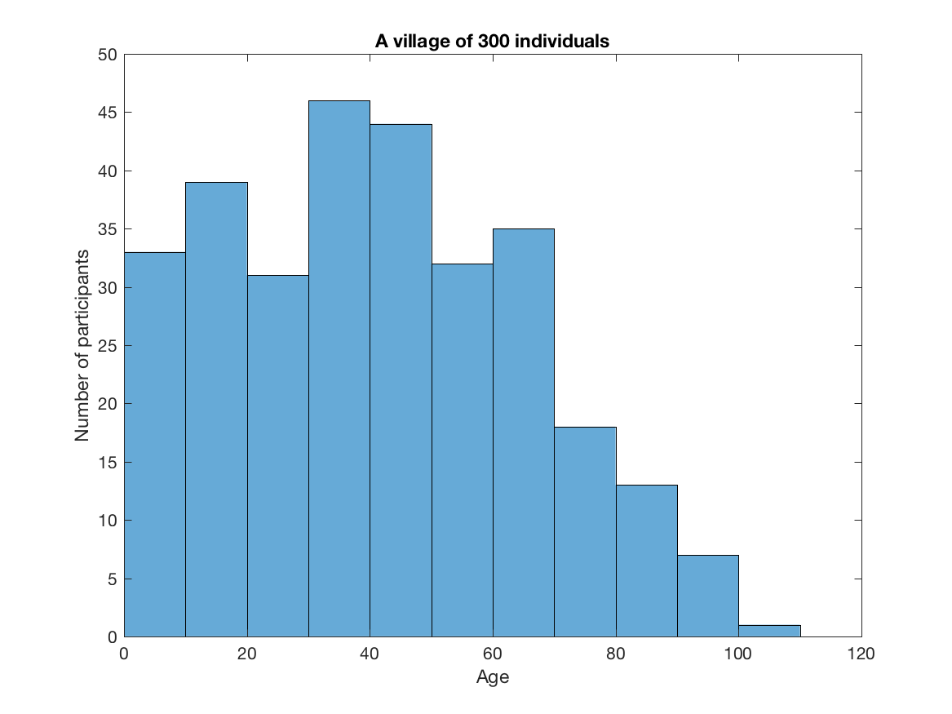
Singling out – a small village with 300 individuals
People counted together based on their “decade” age
We can single out one very old individual which most likely everybody in the village knows
ID | AGE group | Sensitive info (e.g. “was in jail”)
1 | 50 | 0
2 | 40 | 0
3 | 100 | 1
... | 40 | 1
Red = only one in the dataset
Notes:
-> data collection from human participants takes a lot of time and effort is hard do redo. What is often not realized is that many of the decisions regarding data use, opening and archival (end of life) are relevant already in the early stages of research. Here, informed consent is the key. The decision to apply for ethical review is also done in the early stages, for those cases that require ethics review in the Finnish system, it is a lost cause to start thinking about it when reviewer points its missing.
With personal data, the dimension of technical aspects and ethical ones intersect. (laptop example) And of course the case of having your data in a personal computer or an external hard drive which crashes.
Personal data lifecycle is a multifaceted process-> a gradual process of improving your knowledge

Slide 55
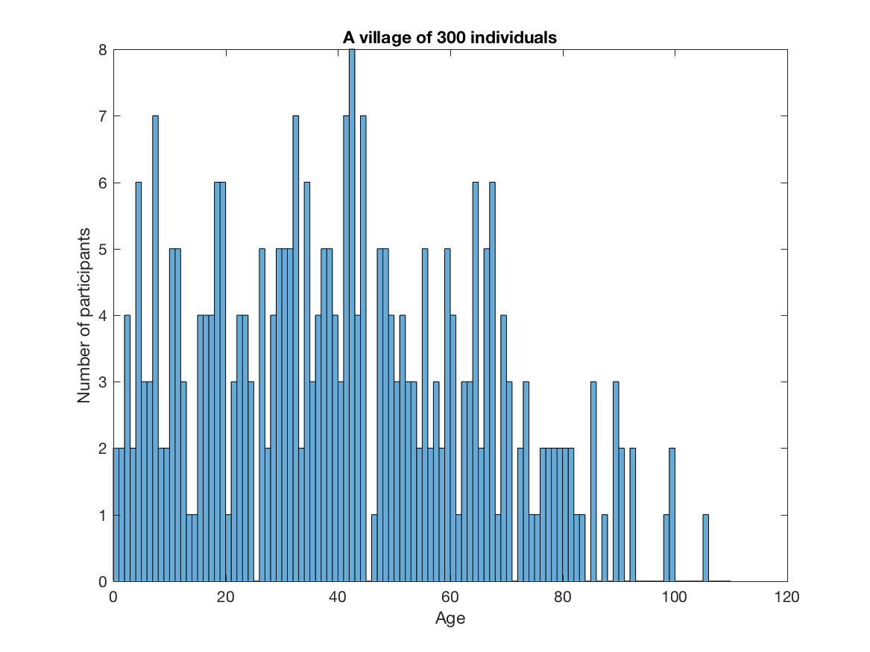
Singling out – a small village with 300 individuals
People counted together based on their age as integer year
Increasing granularity of data, makes the subjects more identifiable.
ID | AGE group | Sensitive info (e.g. “was in jail”)
1 | 56 | 0
2 | 43 | 0
3 | 106 | 1
... | 46 | 1
Red = only one in the dataset
Notes:
-> data collection from human participants takes a lot of time and effort is hard do redo. What is often not realized is that many of the decisions regarding data use, opening and archival (end of life) are relevant already in the early stages of research. Here, informed consent is the key. The decision to apply for ethical review is also done in the early stages, for those cases that require ethics review in the Finnish system, it is a lost cause to start thinking about it when reviewer points its missing.
With personal data, the dimension of technical aspects and ethical ones intersect. (laptop example) And of course the case of having your data in a personal computer or an external hard drive which crashes.
Personal data lifecycle is a multifaceted process-> a gradual process of improving your knowledge

Slide 56
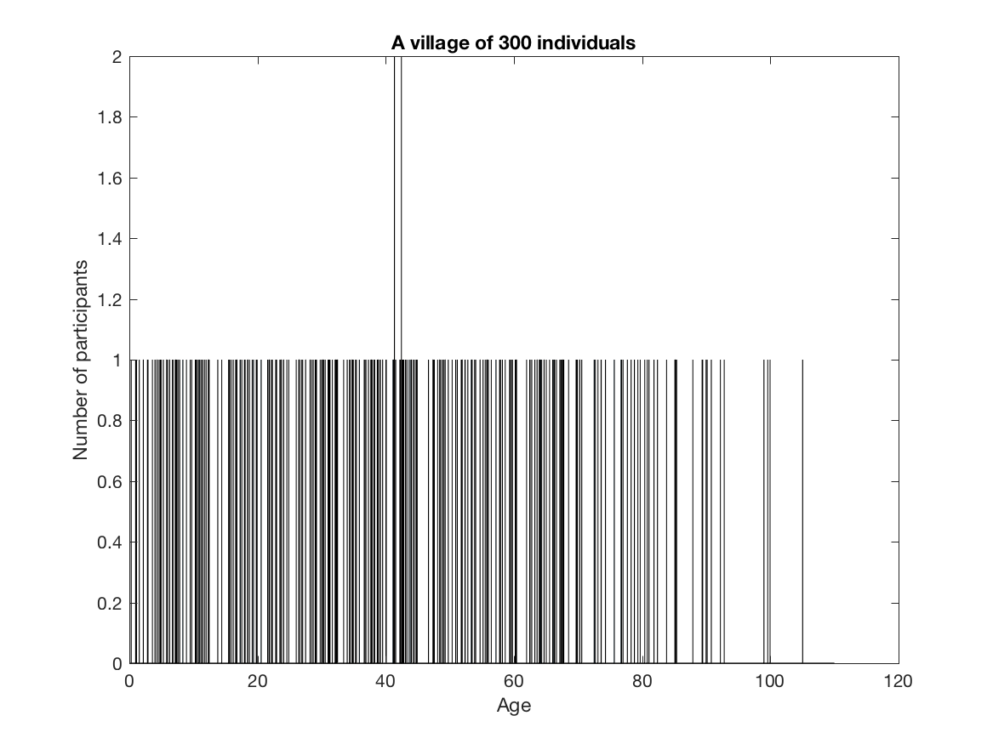
Singling out – a small village with 300 individuals
People counted together based on their age including day and time of birth
We can single out basically every individual
Increasing granularity of data, makes the subjects more identifiable.
K-anonymity = 1
Notes:
-> data collection from human participants takes a lot of time and effort is hard do redo. What is often not realized is that many of the decisions regarding data use, opening and archival (end of life) are relevant already in the early stages of research. Here, informed consent is the key. The decision to apply for ethical review is also done in the early stages, for those cases that require ethics review in the Finnish system, it is a lost cause to start thinking about it when reviewer points its missing.
With personal data, the dimension of technical aspects and ethical ones intersect. (laptop example) And of course the case of having your data in a personal computer or an external hard drive which crashes.
Personal data lifecycle is a multifaceted process-> a gradual process of improving your knowledge

Slide 57
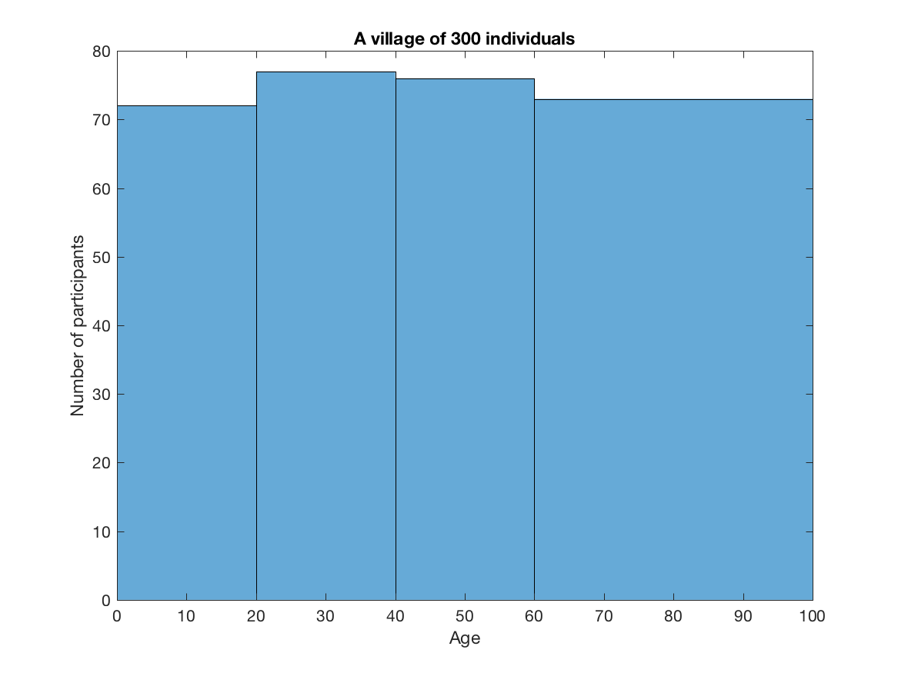
Solution: binning the data into uniform sub-groups
Groups that are less represented should be merged together
This anonymisation method is called generalisation
K-anonymity =~ 70 Each person contained in the release cannot be distinguished from at least k - 1 individuals whose information also appear in the release.
Notes:
-> data collection from human participants takes a lot of time and effort is hard do redo. What is often not realized is that many of the decisions regarding data use, opening and archival (end of life) are relevant already in the early stages of research. Here, informed consent is the key. The decision to apply for ethical review is also done in the early stages, for those cases that require ethics review in the Finnish system, it is a lost cause to start thinking about it when reviewer points its missing.
With personal data, the dimension of technical aspects and ethical ones intersect. (laptop example) And of course the case of having your data in a personal computer or an external hard drive which crashes.
Personal data lifecycle is a multifaceted process-> a gradual process of improving your knowledge

Slide 58
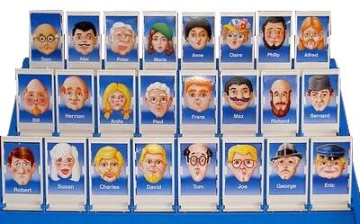
Singling out – more data, lower k-anonymity
With ~4 pieces of information you can uniquely identify a character from “guess who?” board game
Even though each piece of information could be generalised into a broad category, more information makes the individual more identifiable.
Notes:
-> data collection from human participants takes a lot of time and effort is hard do redo. What is often not realized is that many of the decisions regarding data use, opening and archival (end of life) are relevant already in the early stages of research. Here, informed consent is the key. The decision to apply for ethical review is also done in the early stages, for those cases that require ethics review in the Finnish system, it is a lost cause to start thinking about it when reviewer points its missing.
With personal data, the dimension of technical aspects and ethical ones intersect. (laptop example) And of course the case of having your data in a personal computer or an external hard drive which crashes.
Personal data lifecycle is a multifaceted process-> a gradual process of improving your knowledge

Slide 59
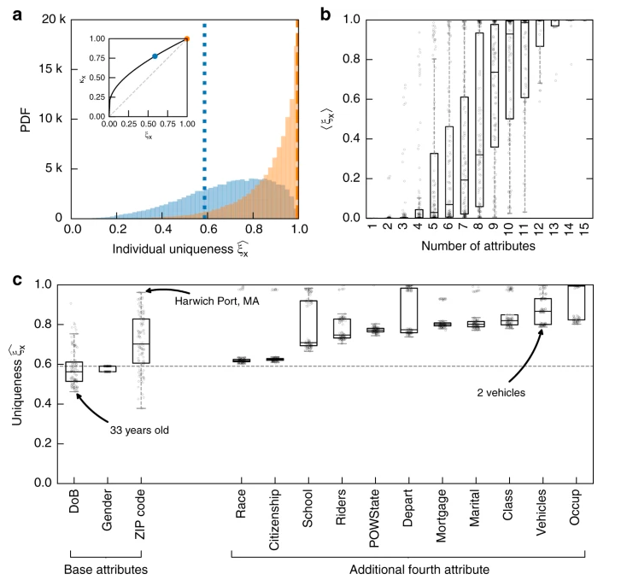
Singling out – more data, lower k-anonymity
With ~15 pieces of information you can uniquely identify 99.98% of the American population.
“Estimating the success of re-identifications in incomplete datasets using generative models” Rocher et al (2019) https://www.nature.com/articles/s41467-019-10933-3
Notes:
-> data collection from human participants takes a lot of time and effort is hard do redo. What is often not realized is that many of the decisions regarding data use, opening and archival (end of life) are relevant already in the early stages of research. Here, informed consent is the key. The decision to apply for ethical review is also done in the early stages, for those cases that require ethics review in the Finnish system, it is a lost cause to start thinking about it when reviewer points its missing.
With personal data, the dimension of technical aspects and ethical ones intersect. (laptop example) And of course the case of having your data in a personal computer or an external hard drive which crashes.
Personal data lifecycle is a multifaceted process-> a gradual process of improving your knowledge

Slide 60
Re-identification from fingerprinting
When you start collecting more rich data from individuals (basically anything related to their body: fingerprints, DNA, eye movements, brain activity, brain morphology, electrocardiogram, gait, voice, face traits) anonymisation becomes impossible, unless you want to make the data unusable.
Data minimisation is still necessary (e.g. removing direct identifiers), and data need to be handle as personal data

Slide 61
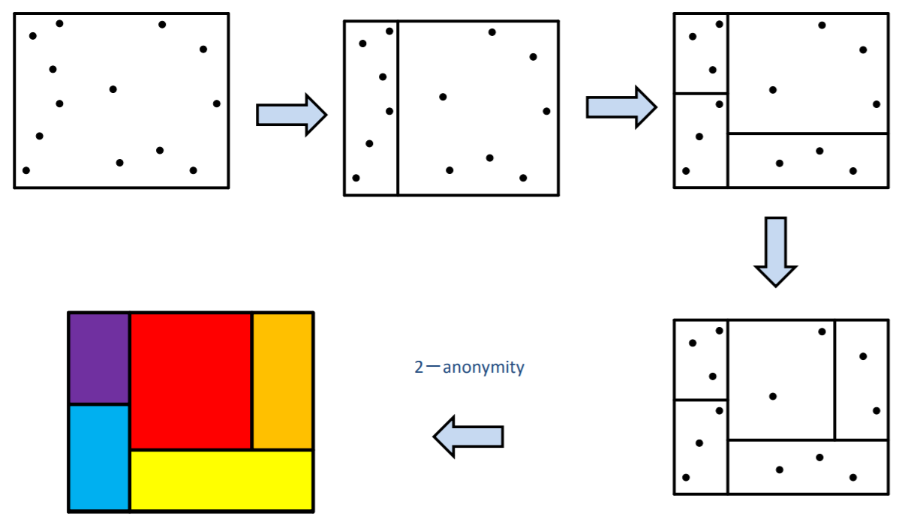
K-anonymity to more identifiers
When more than one identifier is considered, one need to find subgroups.
The more identifiers are added the more it is impossible to achieve k-anonymity without losing data
Same issues as other clustering or dimensionality reduction methods. If the clusters / principal components do not make much sense, it is difficult to claim something generizable about the findings.
Mondrian method (LeFevre et al 2006). Figure from these slides
Notes:
-> data collection from human participants takes a lot of time and effort is hard do redo. What is often not realized is that many of the decisions regarding data use, opening and archival (end of life) are relevant already in the early stages of research. Here, informed consent is the key. The decision to apply for ethical review is also done in the early stages, for those cases that require ethics review in the Finnish system, it is a lost cause to start thinking about it when reviewer points its missing.
With personal data, the dimension of technical aspects and ethical ones intersect. (laptop example) And of course the case of having your data in a personal computer or an external hard drive which crashes.
Personal data lifecycle is a multifaceted process-> a gradual process of improving your knowledge

Slide 62
Re-identification attacks and other risks
Privacy attacks (https://dl.acm.org/doi/abs/10.1145/3436755)
Inference attacks (by analysing the data one can infer information about an individual)
Linkage attacks (e.g. the famous linkage between two public datasets from Netflix and IMDB)
Model extraction attacks (various types, e.g. the original face extracted from a ML model)
When studying a rare population, there are higher chances for the participants to be re-identified
Individuals with rare diseases, individuals that are famous (musicians, celebrities, politicians)

Slide 63
4.3 New challenges posed by AI

Slide 64
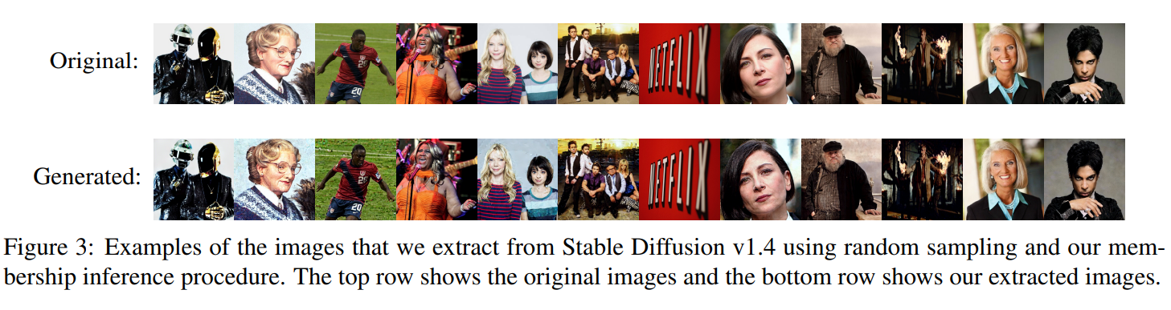
Example of model extraction attack from 2023 using text to image models (stable diffusion)
https://arxiv.org/pdf/2301.13188.pdf

Slide 65
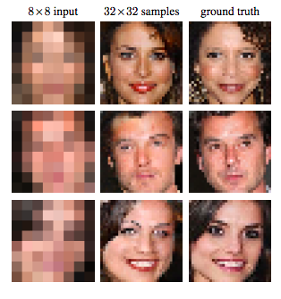
Re-identification through synthetic data
Advances in machine learning technology can potentially allow re-identification of minimised data.
Reconstructing faces from low quality images:
https://arxiv.org/pdf/1702.00783.pdf

Slide 66
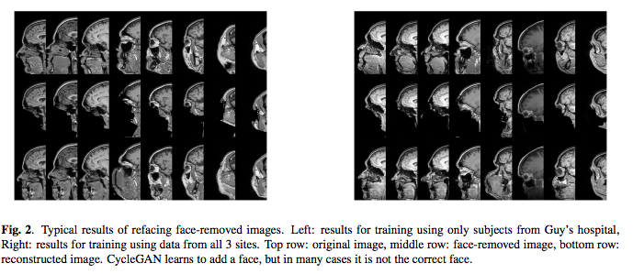
Re-identification through synthetic data
Advances in machine learning technology can potentially allow re-identification of minimised data.
Reconstructing faces from defaced MRIs of the head.
http://www.diva-portal.org/smash/get/diva2:1359959/FULLTEXT01.pdf

Slide 67
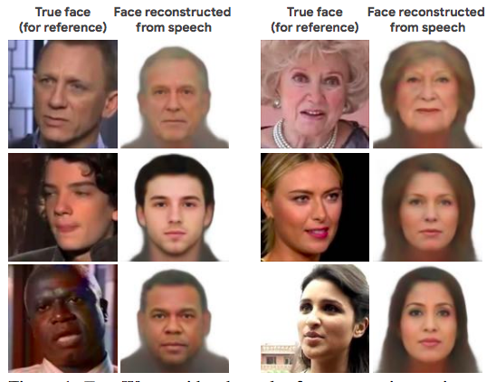
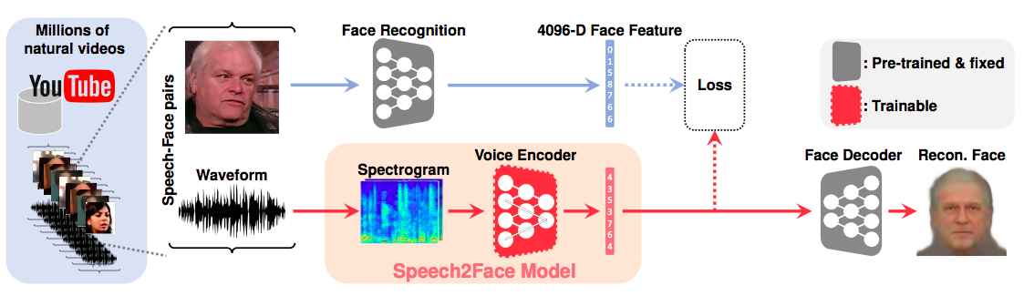
Re-identification through synthetic data
Advances in machine learning technology can potentially allow re-identification of minimised data.
Reconstructing faces from voice recordings
https://openaccess.thecvf.com/content_CVPR_2019/papers/Oh_Speech2Face_Learning_the_Face_Behind_a_Voice_CVPR_2019_paper.pdf

Slide 68
4.4 Anonymisation in practice

Slide 69
Anonymisation before data collection: Privacy by design
Plan your research with minimisation in mind
What is the minimum amount of personal data that I need to answer my research question?
Justify your data/protocol whether you have an hypothesis or explicitly mention that it is exploratory (preregistration and DMP)
Structured data in favour of unstructured data (i.e. avoid open ended questions)
Data Management Plan should mention about your data minimisation strategy.
However, consider also the ethical aspects: e.g. you might collect health data and come across an incidental finding, you still need to be able to contact the participant before minimising the data

Slide 70
Anonymisation before data collection: Privacy by design with background data
Restrict as much as possible the range of answers
Do not promise that data will be fully anonymous if you do not have proof to show the participant that it will be truly anonymous or if you do not have an anonymisation strategy to show.
In doubt, just tell them that you are collecting personal data and provide a privacy notice along with the consent to participate to your study.

Slide 71
Anonymisation after data collection
Participants’ background information: Destroy, obfuscate, generalise background variables according to the table at https://www.fsd.tuni.fi/en/services/data-management-guidelines/anonymisation-and-identifiers/
Health data: minimise file headers, remove direct identifiers (e.g. faces from MRI)
Geospatial data: https://www.sciencedirect.com/science/article/pii/S0198971520302465#f0010
Audio visual data
…
What is your data?

Slide 72
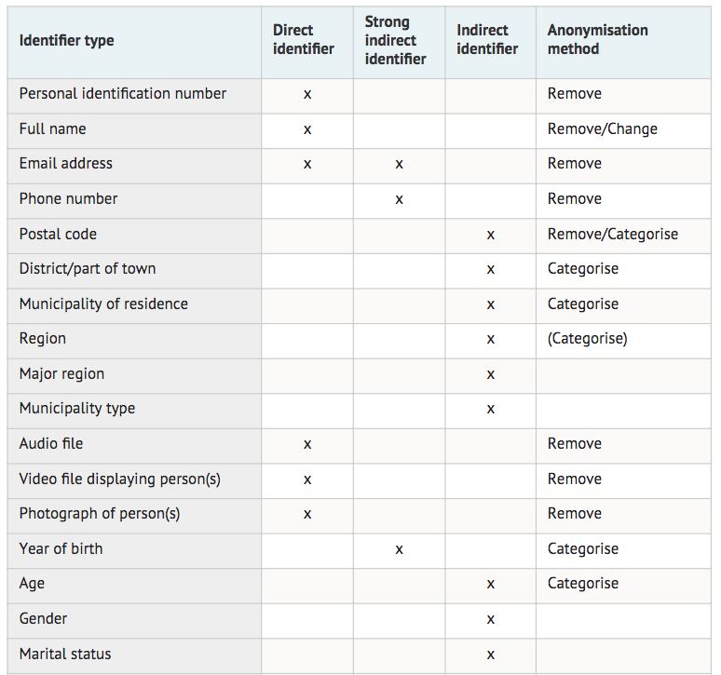
https://www.fsd.uta.fi/aineistonhallinta/en/anonymisation-and-identifiers.html

Slide 73
Anonymisation after data collection: some tools
https://amnesia.openaire.eu/ (tabular data)
https://arx.deidentifier.org/ (tabular data)
https://sourceforge.net/projects/anony-toolkit/ (tabular data)
https://surfer.nmr.mgh.harvard.edu/fswiki/mri_deface (MRI)
http://mist-deid.sourceforge.net/ (unstructured medical records)
https://nlp.stanford.edu/software/CRF-NER.html (NLP for unstructured text)

Slide 74
Anonymisation in qualitative research
Various qualitative methods produce data in the form of text (interview transcripts, field notes)
The data can contain all sorts of direct and indirect identifiers
Manual minimisation (anonymisation) follows these rules:
Replacing personal names with aliases
Categorising proper nouns
Changing or removing sensitive information
Categorising background information
Changing values of identifiers
Advances in ML allow for NER (Name Entity Recognition). See a recent example https://arxiv.org/abs/2208.13081 (1% de-anonymisation rate)
https://www.fsd.tuni.fi/en/services/data-management-guidelines/anonymisation-and-identifiers/#anonymising-qualitative-data

Slide 75
Name Entity Recognition
Subtask of natural language processing (NLP) that involves identifying and classifying named entities in unstructured text. (ref)
Named entities are typically proper nouns, such as names of people, organizations, locations, dates, and other specific items e.g. special categories of personal data.
Personal data revealing racial or ethnic origin; Political opinions; Religious or philosophical beliefs; Trade union membership; Genetic data and biometric data processed for the purpose of uniquely identifying a natural person; Data concerning health; Data concerning a natural person’s sex life or sexual orientation.
The goal of NER is to automatically detect these entities and categorize them into predefined classes.
Different implementations according to fields (a medical NER system might focus on medical terms, a legal NER on legal cases etc)
Practical tips: it should run locally, it can be challenging to set up, it will always require manual quality control

Slide 76
Anonymisation in qualitative research: practical tips
Good planning leads to excellent anonymisation
Do not anonymise like a robot, decide before starting what is relevant
E.g. family and social relationships are important for the research question, then terms like “mother” “sister” “neighbour” should stay and when the names of these individuals appear in full, they can be replaced with the appellative.
Counter-example: family relationships do not matter, so “mother” and “sister” could both be replaced with “a close relative”.
Delete everything that is not relevant
It is challenging to prove that the anonymised text is truly anonymous, especially when linkage attacks are possible (e.g. anonymised tweets can be re-identify)
When possible, use coding of the interviews + concepts, but remember that you might still end up with fingerprints

Slide 77
4.5. Workflows when anonymisation is not possible

Slide 78
When anonymisation is not possible
Adopt secure workflows (use remote computing, encryption)
Keep the data in the safest place (e.g. SECDATA, CSC SD)
Bring the code to the data
Code and data on same system
Federated analysis approach (usually via containers)
Bring (part of) the data to your code
Subpart of the data e.g. Beacons in genomics (https://www.nature.com/articles/s41587-019-0046-x)
Synthetic data with same statistical properties of the data you work with (https://arxiv.org/abs/1912.04439 )

Slide 79
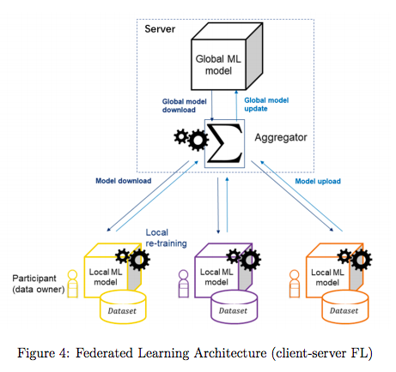
Federated analysis approaches
Data stays with owners who can run the same code
Aggregator can join models from multiple data owners
Figure from https://aaltodoc.aalto.fi/bitstream/handle/123456789/43561/master_Xia_Yuxi_2020.pdf?sequence=1&isAllowed=y

Slide 80
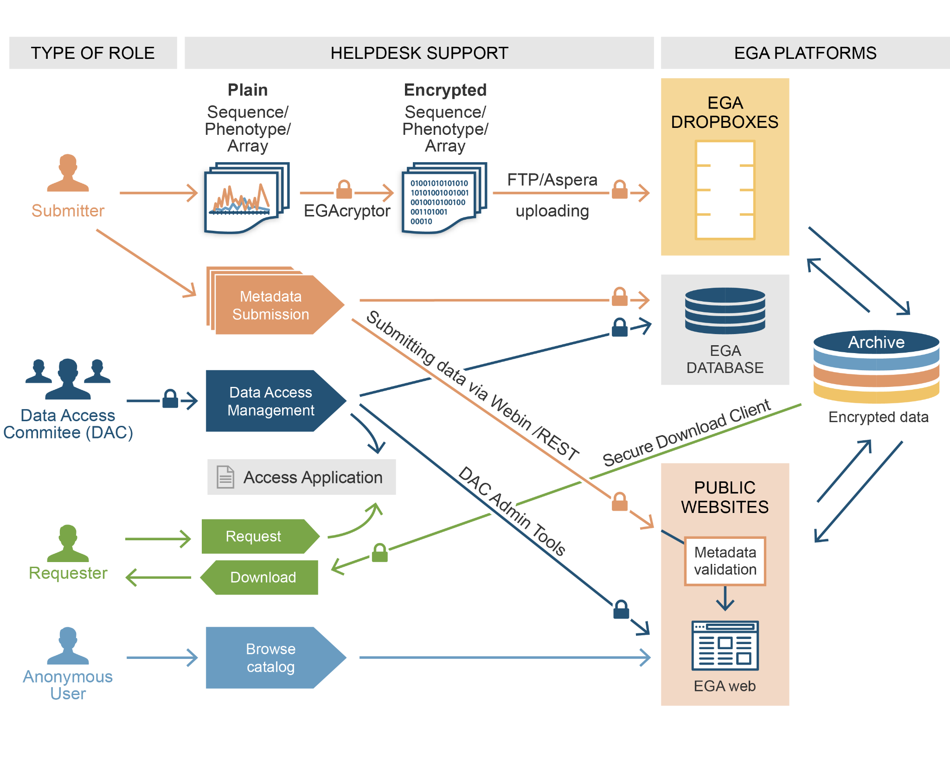
Data access control
Procedure adopted by the (federated) EGA (European Genome Phenome Archive)
In the federated approach, “Download” is replaced with remote secure computing
Figure from https://ega-archive.org/about/introduction

Slide 81
Other solutions
Confidential computing (encrypted containers on secure clusters)
Differential privacy (“perturb” the data while keeping their covariance structure)
Data synthesis (work on a simulated dataset from the original data)
https://github.com/DPBayes/twinify

Slide 82
5. Reflections on anonymisation, ethics, and open science

Slide 83
Research ethics in companies?
There are no explicit incentives to be ethical:
Maximising profits and minimising taxes within legal bounds
Intellectual property for the private interests
However in some fields ethical review is required (e.g. clinical trials)

Slide 84
Other legislations that affect research
As ethics is not only about privacy, legal requirements are not only related to data protection
Open Data Directive
Artificial Intelligence Act (proposal)
Clinical trials regulation
Protection for animals used in research
Biobank legislations (at the national level)
However in some fields ethical review is required (e.g. clinical trials)

Slide 85
Data minimisation: start with your own data
Understand your own privacy, your personal data, evaluate the risks that you expose yourself to. Europe is the best place to be!
Digital traces of personal data you leave around (cookies, GPS trackers, the apps you use)
(hidden) metadata in files: sometimes it is not just what you see
Where data are stored matters: Schrems vs FISA (Foreign Intelligence Surveillance Act)
Consider the perspective that as an employee of an organization you have accepted that some of your data is transferred overseas, however your study participants did not sign any agreement with third parties
Know your rights about your data
Familiarize yourself with (and adopt!) encryption, secure connectivity (MFA, SSH keys, https), secure file sharing and communication (funet, Signal)

Slide 86
Opening and sharing data must be part of the transparent process of doing research
Open science practices bring high benefits to researchers (higher citations, higher impact) and to the future of science itself (reproducibility, generalisability, sustainability)
“As open as possible, as closed as necessary”
GDPR however can set restrictions on the secondary use of data: opening data for verification or opening data for reuse?
Personal data and long term preservation

Slide 87
Can anonymised data be opened/shared?
Anonymised data are not personal data so they do not fall under the restriction we have seen before
However always consider ethical implications
What happens when a subject asks to be removed from an open dataset since they can recognize themselves?
What we promise to be anonymous today, might not be anonymous anymore in the future
Although it can be impossible to re-identify an individual, these are still data given by persons who might not be approving re-usage of data for purposes they did not agree with. Anonymous data is often released under CC0; there is no license that forbids large language models to use open data to train the next GPT Language Model
See section “2.6 Why ethics is an important issue in Anonymisation” here: http://ukanon.net/wp-content/uploads/2015/05/The-Anonymisation-Decision-making-Framework.pdf

Slide 88
Can pseudonymised/minimised data be opened/shared?
It always depends on what you have promised to the subjects
Sharing with partner institutions can be done but it always requires some forms of legal agreements between parties Sharing outside EU might not always be possible.
Personal data opening: early days in Europe.
Personal research data should never be fully open, we can make data available on reasonable request as long as the request is NOT handled by the researcher
We need to clarify to the data subject the“secondary use of data”. For health and social data in Finland we have the Toisiolaki. EDPB is working on solving issues related to “broad consent”.
There are still ethical implications even if the legal side is fine (data leaks, data abuse, data misuse)
Existing and upcoming solution: EGA, SD Submit

Slide 89
Unpopular opinion: should all data be open? should we instead focus more on opening the methods?
Efforts on opening data for secondary use, only after data appraisal: lawfully and ethically opening personal data is a large coordinated effort between researchers, data stewards, lawyers, ethics, IT infra.
Pre-registration of protocols and registered reports could enhance the research project more than a small open dataset

Slide 90
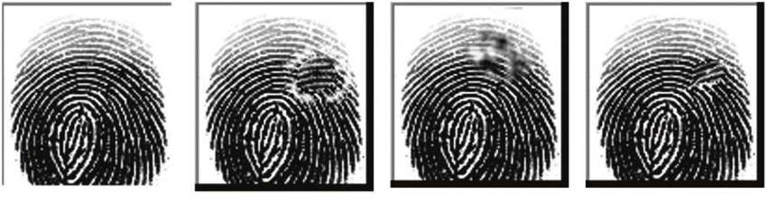
Is data protection in EU sending researchers away?
Sensitive datasets collected in developing countries (e.g. the largest fingerprint open dataset is from Africa, N = 600)
Sokoto Coventry Fingerprint Dataset

Slide 91
TL;DR
Take home messages

Slide 92
Take home messages
You can collect any personal data, but take care of the data protection according to the risks
Held the highest standard of ethics and law towards your subjects
Anonymise if possible, minimise otherwise, share on request is fine, but start working on the process before data collection
(when possible) talk about these issues with the participants, make them comfortable, don’t leave them alone with consent forms and privacy notices

Slide 93
THE END
Thank you!

